Slide 1


Research Paper
Team Name: SMART DROPS
Team ID: PY0129
Team Lead: Mohamed Arshath M
Team Members: Sanjay K,
Sonika M,
Rakshitha K S,
Vaisika P,
Sai Ragavi A C

Slide 2

Problem statement
Traditional irrigation methods leads to heavily on manual operation and fixed schedules, which often lead to overwatering or underwatering of crops. This results in inefficient water usage, increased labor effort, and reduced crop productivity. Additionally, farmers lack real-time information about soil and environmental conditions, making it difficult to make accurate irrigation decisions. There is also no proper mechanism to detect issues such as water flow failure or system faults. Therefore, there is a need for a smart and automated irrigation system that can monitor field conditions in real time, optimize water usage, reduce manual work, and provide remote monitoring and control for efficient agricultural management.

Slide 3
Objectives
1.Develop a Smart Irrigation System using IoT
2.Monitor soil moisture and environmental conditions in real time
3.Automate water pump control based on soil moisture levels
4.Reduce water wastage and improve efficiency
5.Enable remote monitoring and control via web dashboard
6.Detect faults and send alerts for system issues
7.Minimize manual effort and support smart farming

Slide 4
Solution
The proposed solution is a Smart Flow System that uses sensors and an ESP32 microcontroller to monitor soil moisture and environmental conditions in real time. Based on the collected data, the system automatically controls the water pump to supply water only when required, ensuring efficient irrigation. A web-based dashboard allows users to monitor system status and manually control the pump remotely. The system also includes a water flow sensor to detect issues and send alerts, making irrigation more reliable, automated, and water-efficient.

Slide 5
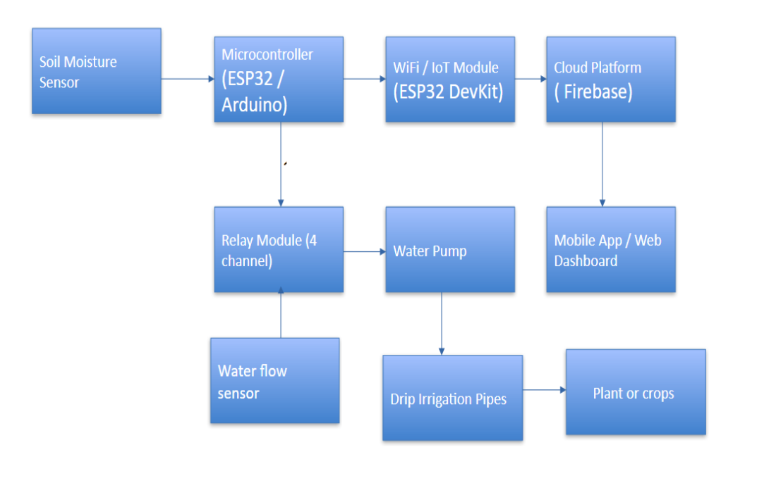
Methodology
Tech Stack:
1.Hardware: ESP32, Sensors, Relay Module, Pump
2.Software: Arduino IDE (Embedded C)
3.Backend: Flask (Python)
4.Frontend: HTML, CSS
5.Communication: WiFi (IoT)
6.Database: SQLite (for storing sensor data)
Methodology:
The Smart Irrigation System is developed using a sensor-based and IoT approach. Sensors such as soil moisture, and water flow continuously collect real-time data from the field. This data is processed by the ESP32 microcontroller, which decides whether irrigation is required based on predefined conditions. If the soil moisture level is low, the system automatically activates the water pump using a relay module. The data is transmitted via WiFi to a Flask-based backend and displayed on a web dashboard for real-time monitoring and control. Users can also manually operate the system, while alerts are generated in case of faults, ensuring efficient and reliable irrigation management.
Flow Chart:

Slide 6
Reference
Github repo:
LaTex link:
https://github.com/PyExpo2K26/PY26129.git
https://www.overleaf.com/read/nmzyhmkygkch#2a8d07

